Slide 1
Coronavirus – Covid19 Overview
10th March 2020
Data as of 17:00 10/03/20
Dr Justin Varney, Director of Public Health

Slide 2
Coronavirus- Covid19
Coronaviruses (CoV) are a large family of viruses that cause illness ranging from the common cold to more severe diseases such as Middle East Respiratory Syndrome (MERS-CoV) and Severe Acute Respiratory Syndrome (SARS-CoV).
As a group, coronaviruses are common across the world. Typical symptoms of coronavirus include fever and a cough that may progress to a severe pneumonia causing shortness of breath and breathing difficulties. This is different from the flu virus.
Novel coronavirus (COVID-19) is a new strain of coronavirus first identified in Wuhan City, China, but now identified and spreading across the globe.
It is expected that for most of the population symptoms will be mild and mimic the common cold. However, more severe symptoms may be seen in people with weakened immune systems, older people, and those with long-term conditions like diabetes, cancer and chronic lung disease.
Current modelling suggests over 80% of the population will get the disease if it reaches pandemic scale. The current mortality rate is around 1%, although this is highest among the elderly and those with chronic health conditions.

Slide 3
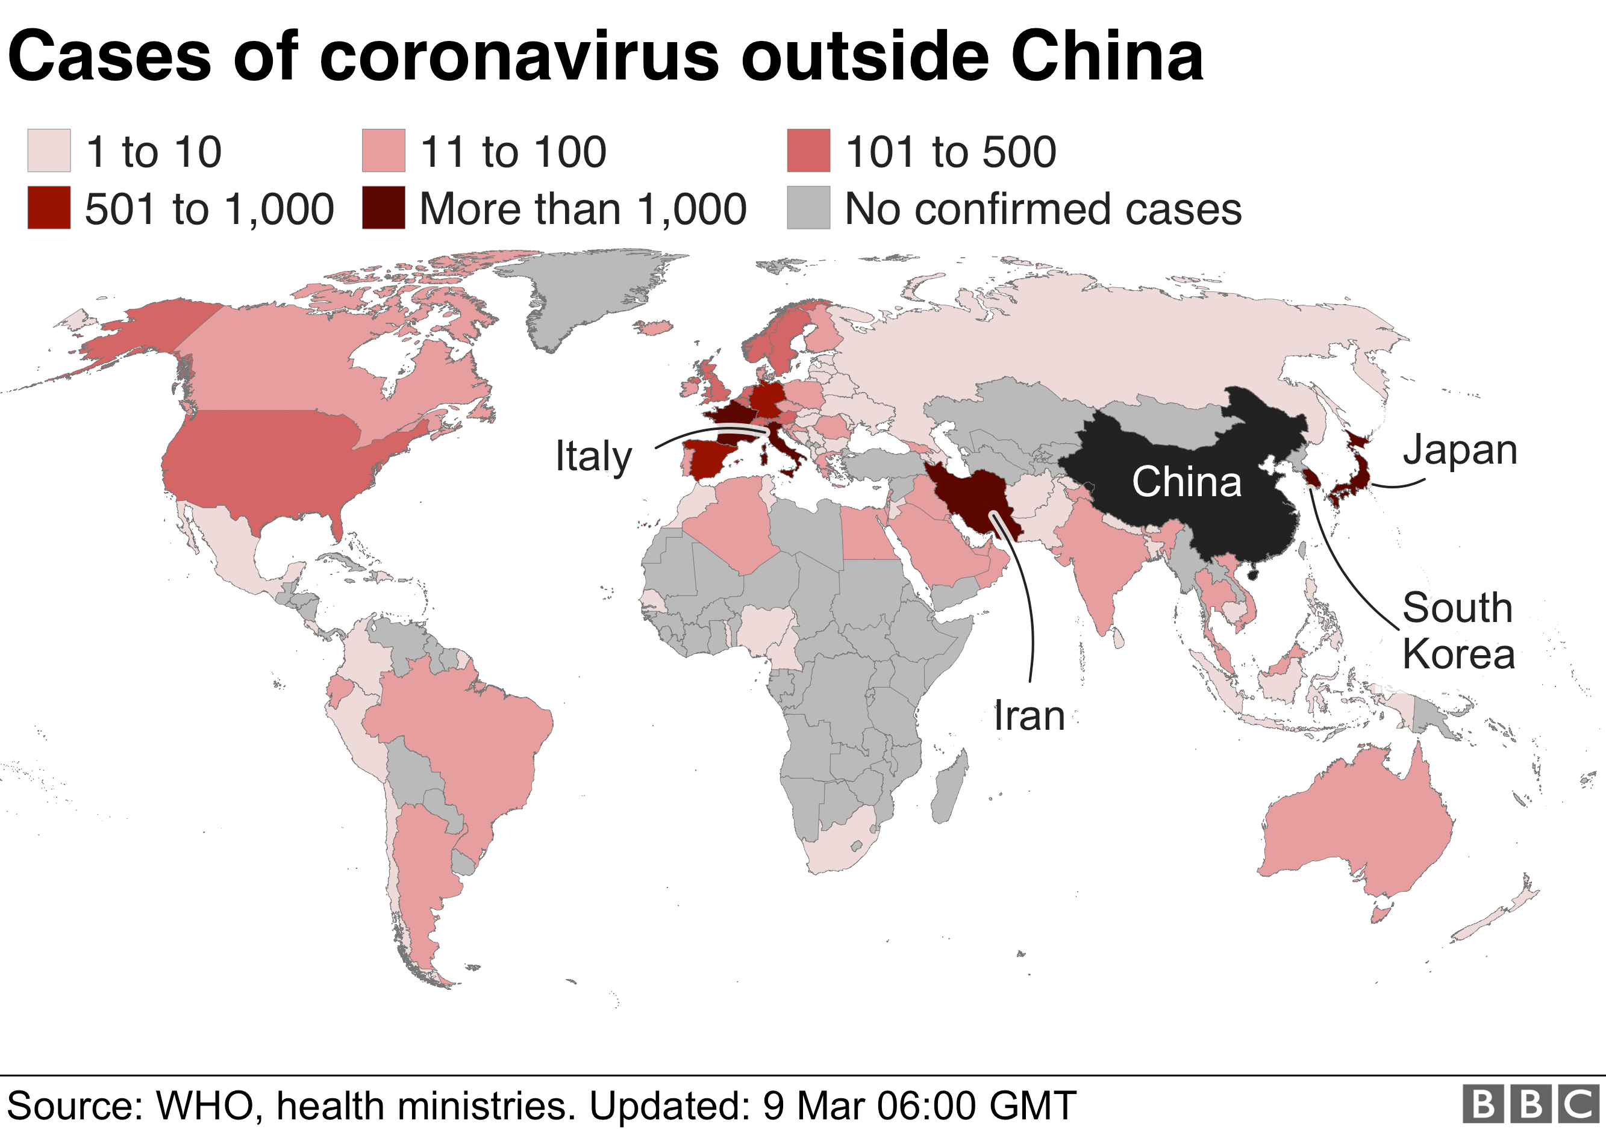
Current Global Picture
About 80,900 people in China have been infected with coronavirus since its emergence in the city of Wuhan, Hubei province, in December.
But there have also been 29,000 cases outside China, according to World Health Organization (WHO) figures

Slide 4
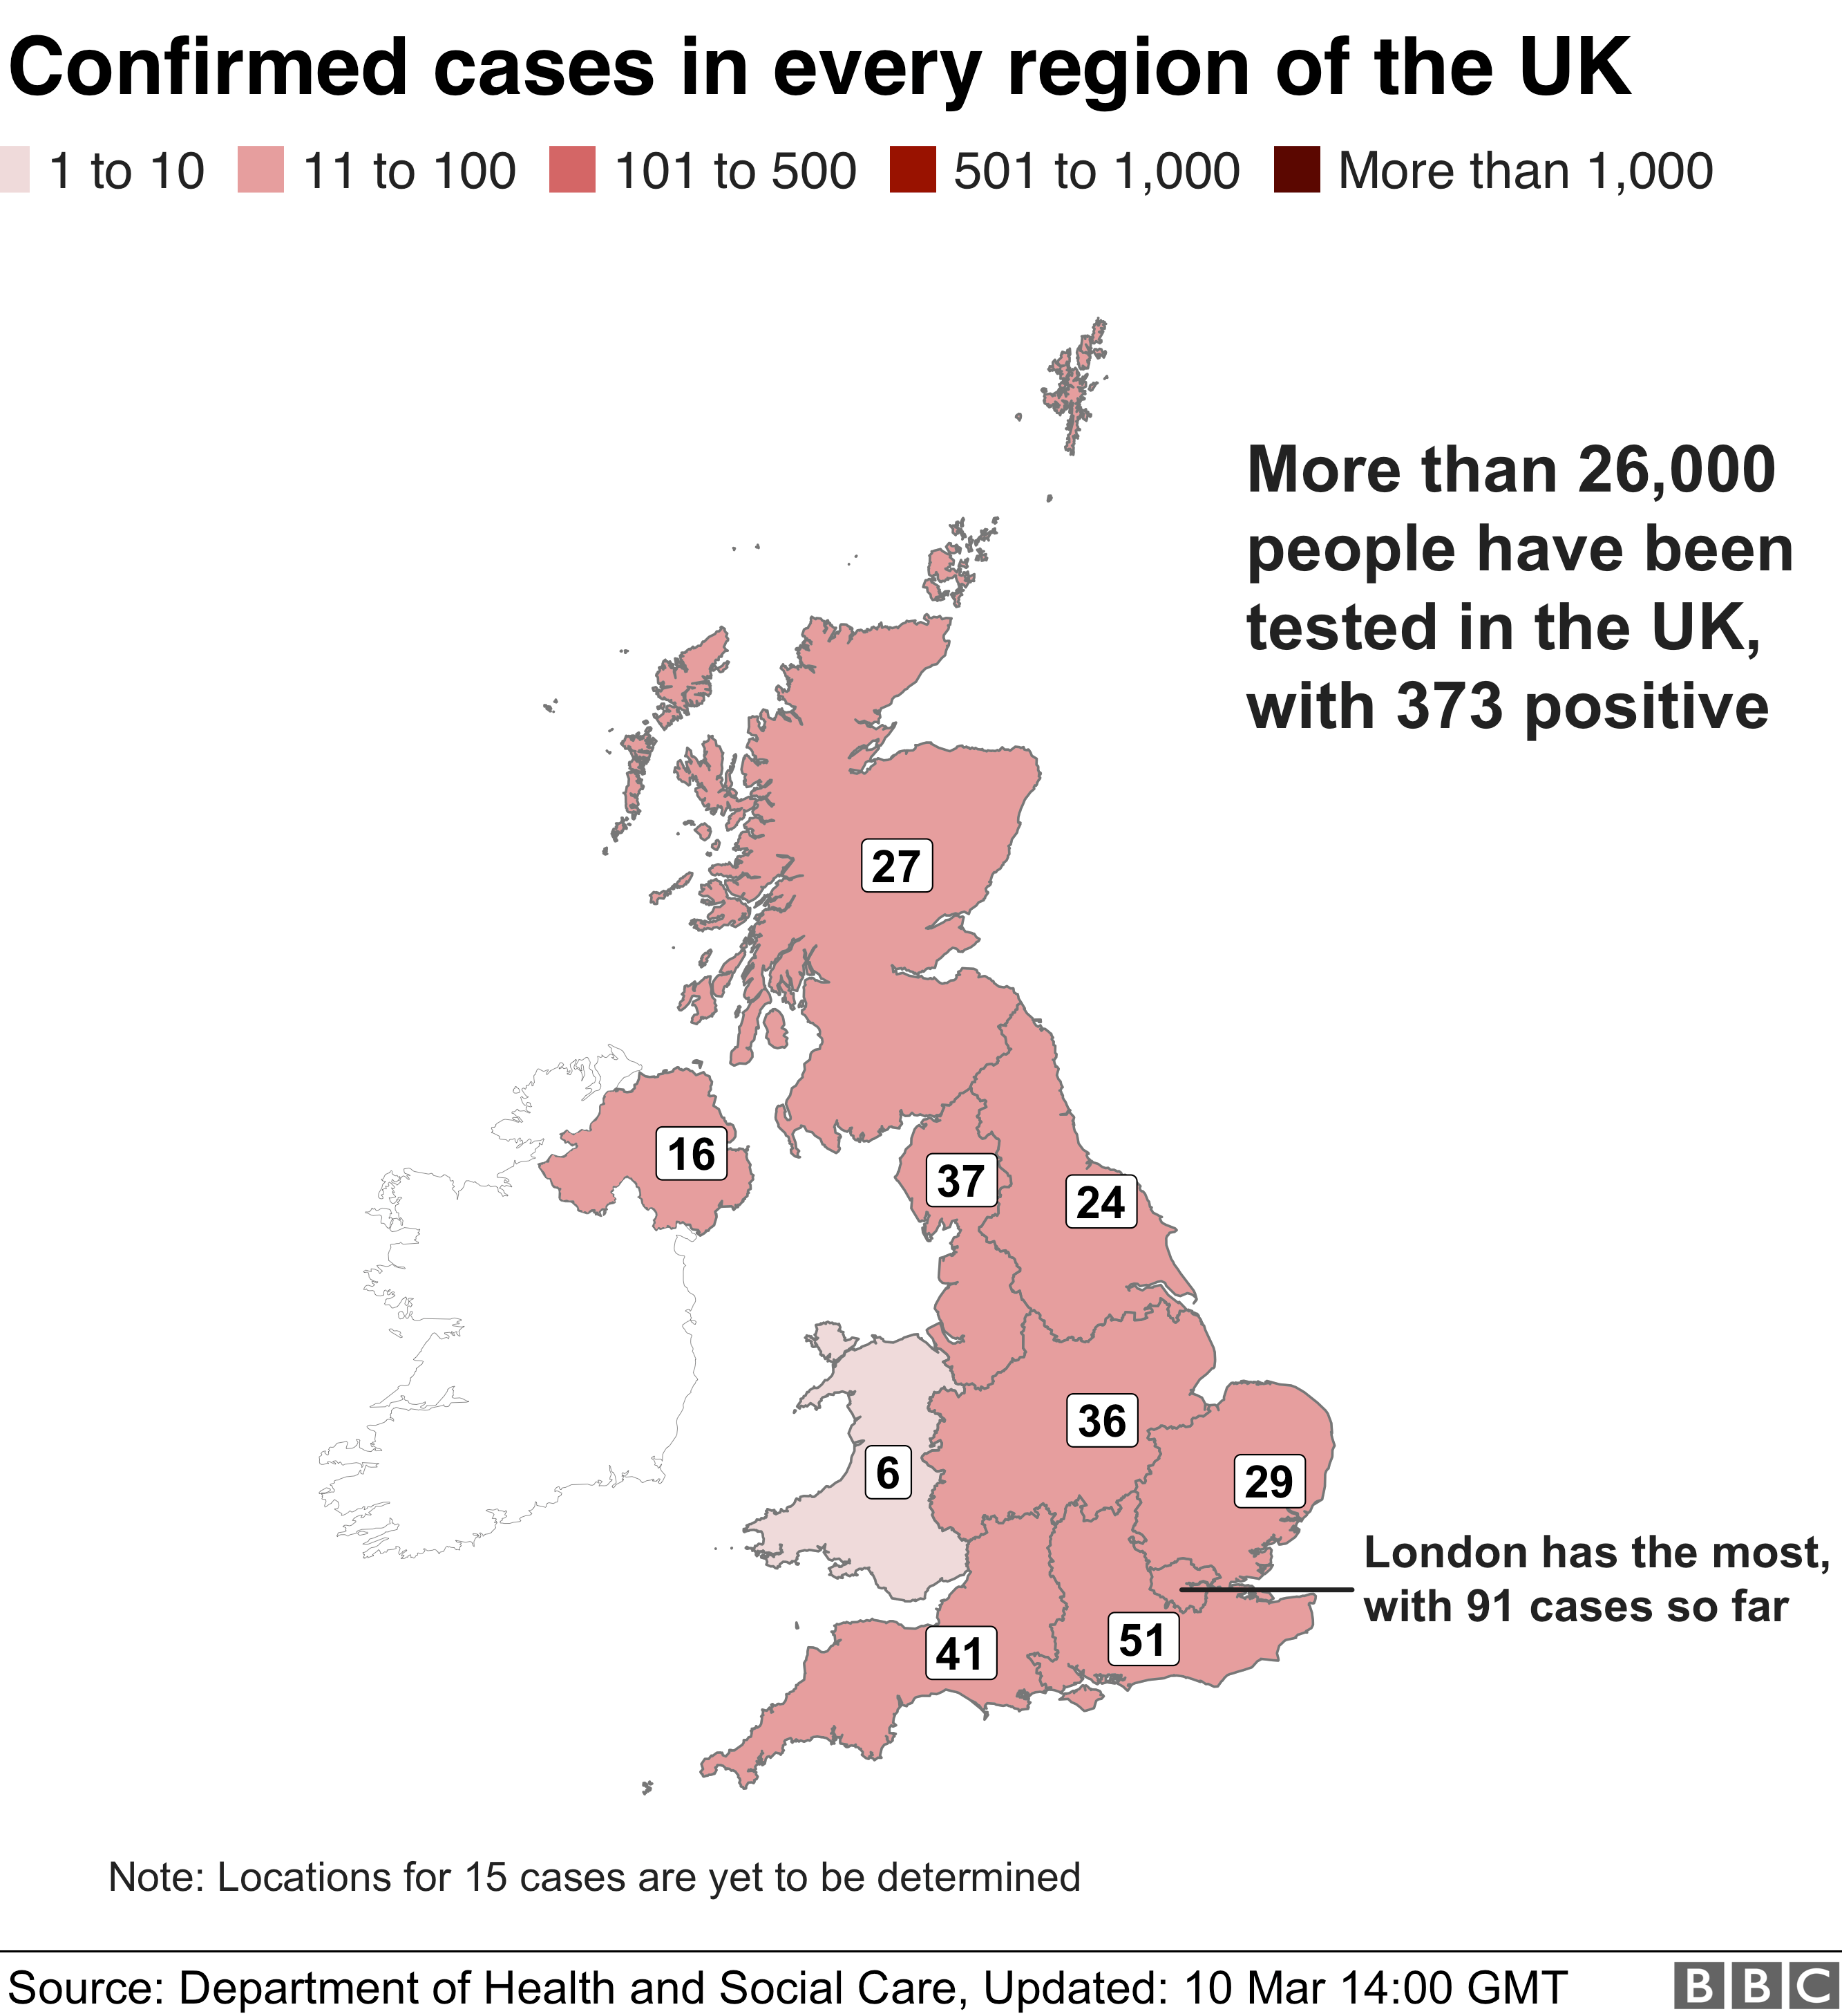
Current UK picture
As of 9am on 10 March 2020, 26,261 people have been tested in the UK, of which 25,888 were confirmed negative and 373 were confirmed as positive. Six patients who tested positive for COVID-19 have died.
In the West Midlands:
  Birmingham 1 case
  Coventry 3 cases
  Staffordshire 4 cases
  Warwickshire 4 cases
  Wolverhampton 3 case
  Dudley 1 case
  Herefordshire 1 case
  Shropshire 1 case

Slide 5
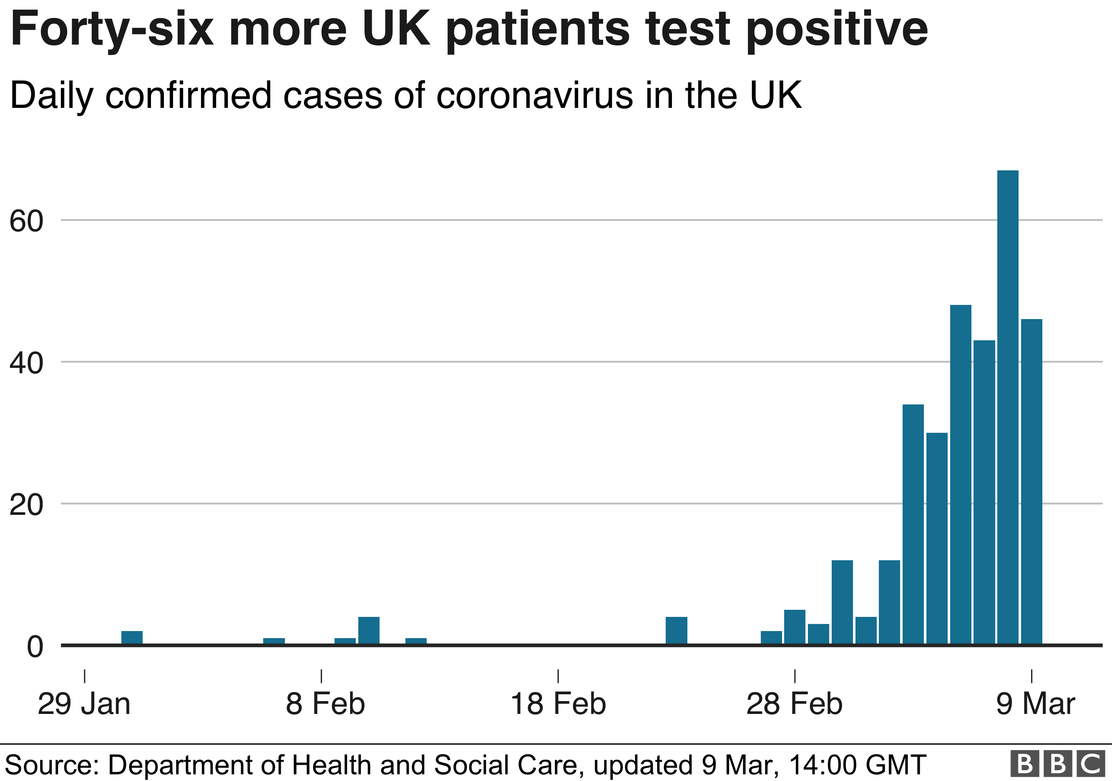

Slide 6
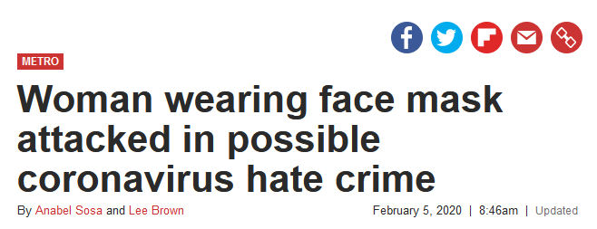
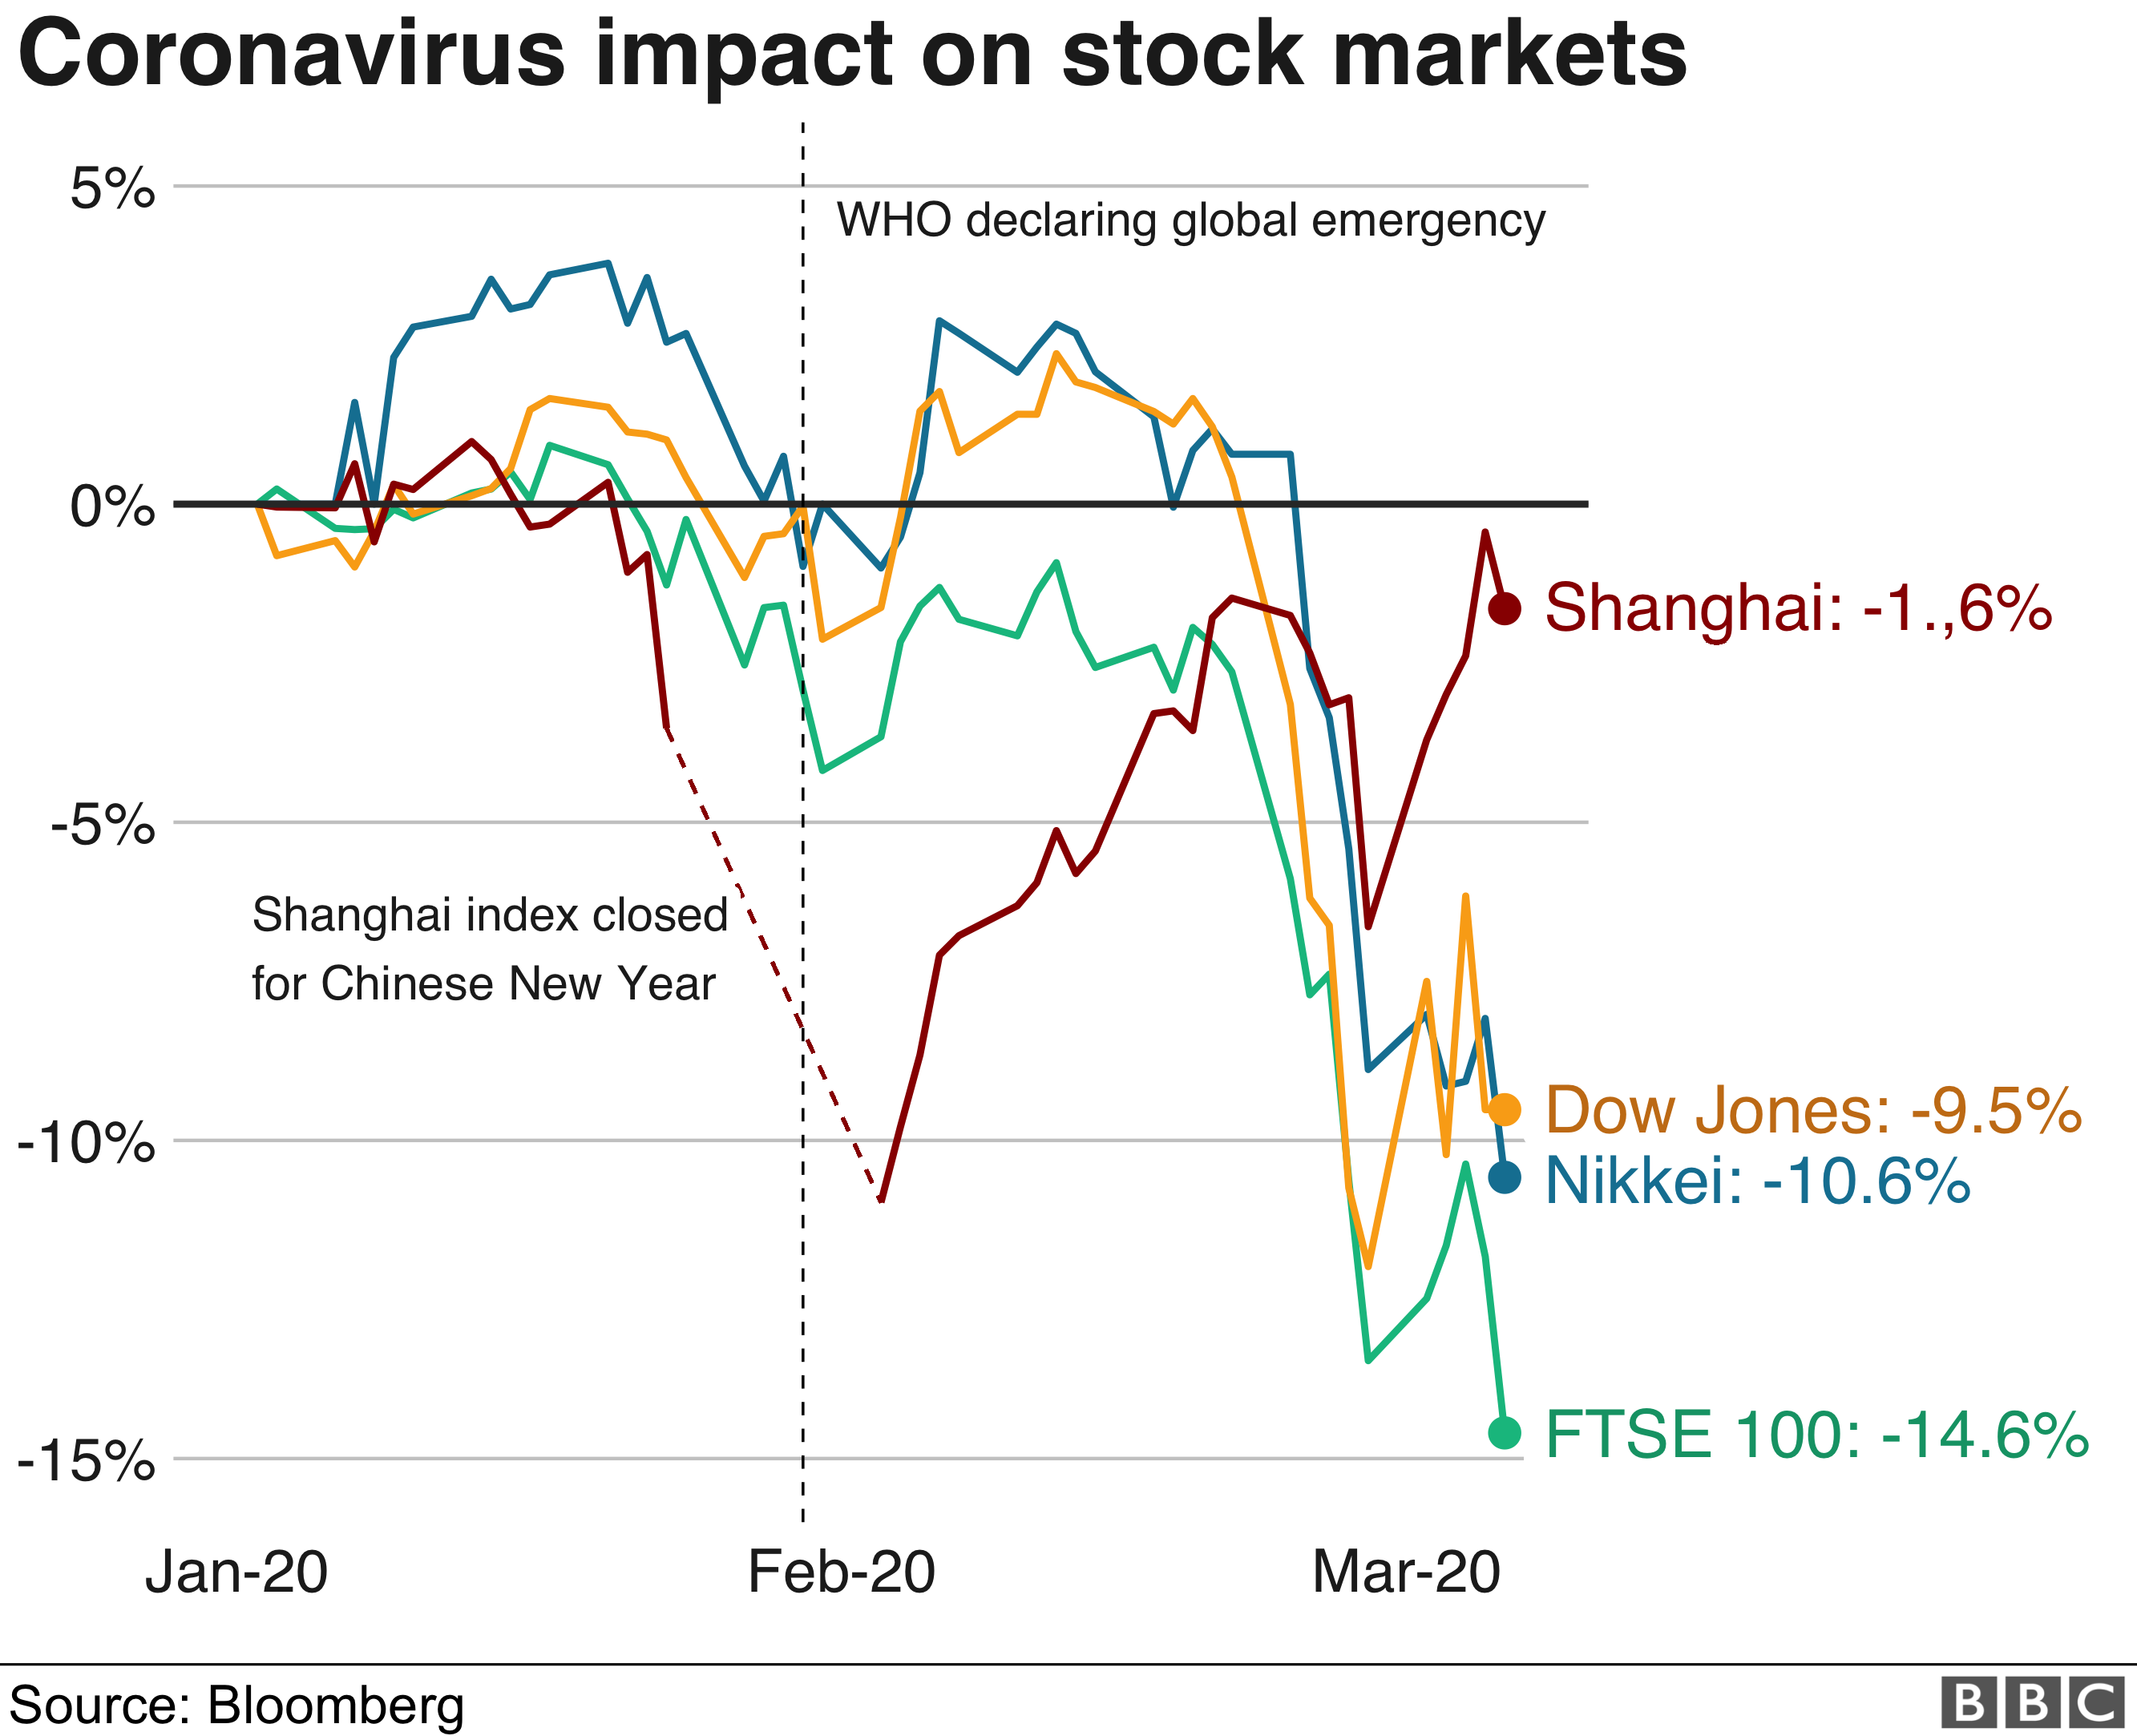
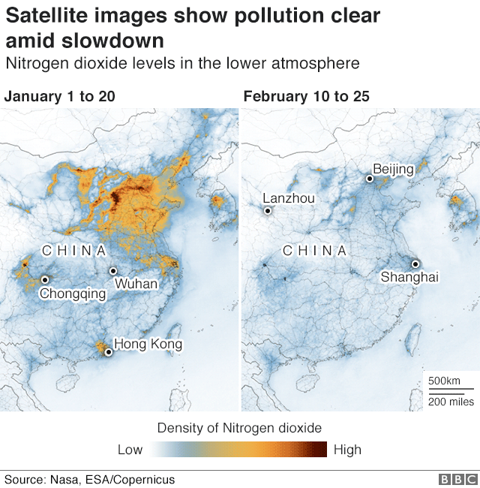
Wider impacts of Covid19
Economic Shock Impact
Community Cohesion Issues
Air Quality Impact

Slide 7
Isolation & Testing Advice
Self-isolate for 14 days (even if symptom free)
Self-isolate for 14 days if develop symptoms of fever, cough, short of breath
Contact with known case
Returned from any of the following areas in the last 14 days:
  Iran
  Hubei province in China
  special care zones in South Korea
  Italy (returning since 9th March)
Returned from any of the following within the last 14 days:
mainland China outside of Hubei province
Italy outside of the lockdown areas
South Korea outside of the special care zones
Cambodia, Vietnam, Thailand, Laos, Myanmar
Hong Kong, Macau
Japan
Malaysia, Singapore, Taiwan
Use the NHS Covid tool to find out what to do next https://www.nhs.uk/conditions/coronavirus-covid-19/

Slide 8
Testing, Contact tracing & Management
111 are providing the single point of contact for testing through the website and telephone line.
The NHSEI coordinating centre is responsible for arranging the test and giving the patient the result.
Community testing is led by NHSE/I regionally, community teams are in place locally.
If positive case – hospital arranges medical assessment, if well and able to self-isolate without risk then home isolation, if unstable or high risk then admitted to infectious disease bed. Public Health England undertake contact tracing of people at risk and contact them to advice of risk and ask for self-isolation for incubation period.
If negative – self-isolation continues if meets case definition until outside of incubation period.

Slide 9
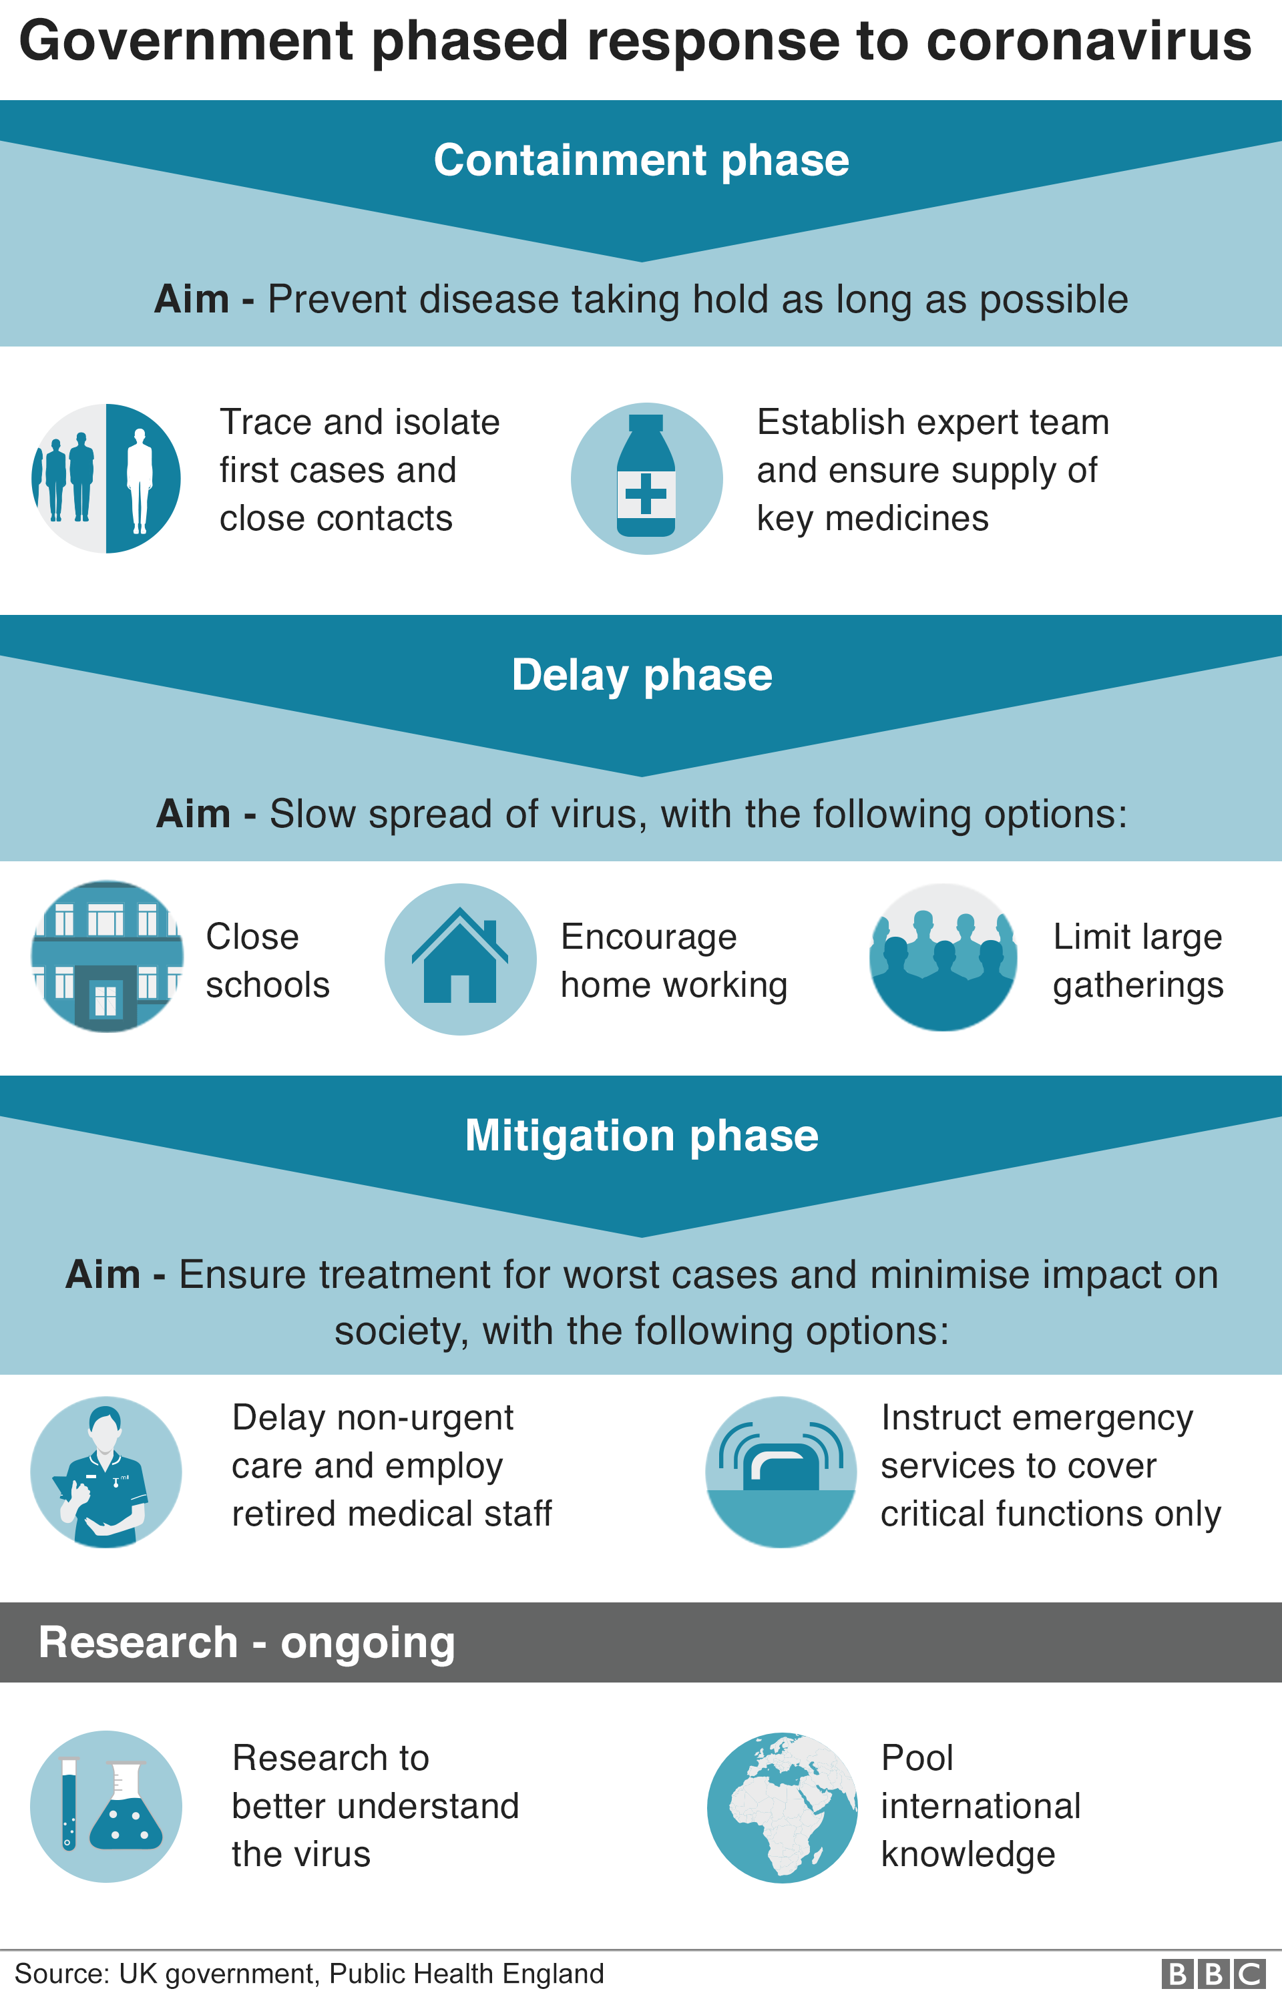
National Response Action Plan
Containment – CURRENT PHASE
Procedures to detect and isolate the first cases of COVID-19 as they emerge in the UK
Included port entry information, Foreign office travel advice
Refresh and preparation of business continuity plans & new legislation
Delay
Delay the onset of an epidemic if it becomes inevitable. These include case finding and isolation of early cases.
Focus on shifting societal norms & individual actions to reduce spread.
Prepare NHS and social care for peak.
Potential to start social distancing interventions e.g. stop mass gatherings
Research
Gather information on disease patterns & treatment
Mitigate
Business continuity measures come into play across society

Slide 10
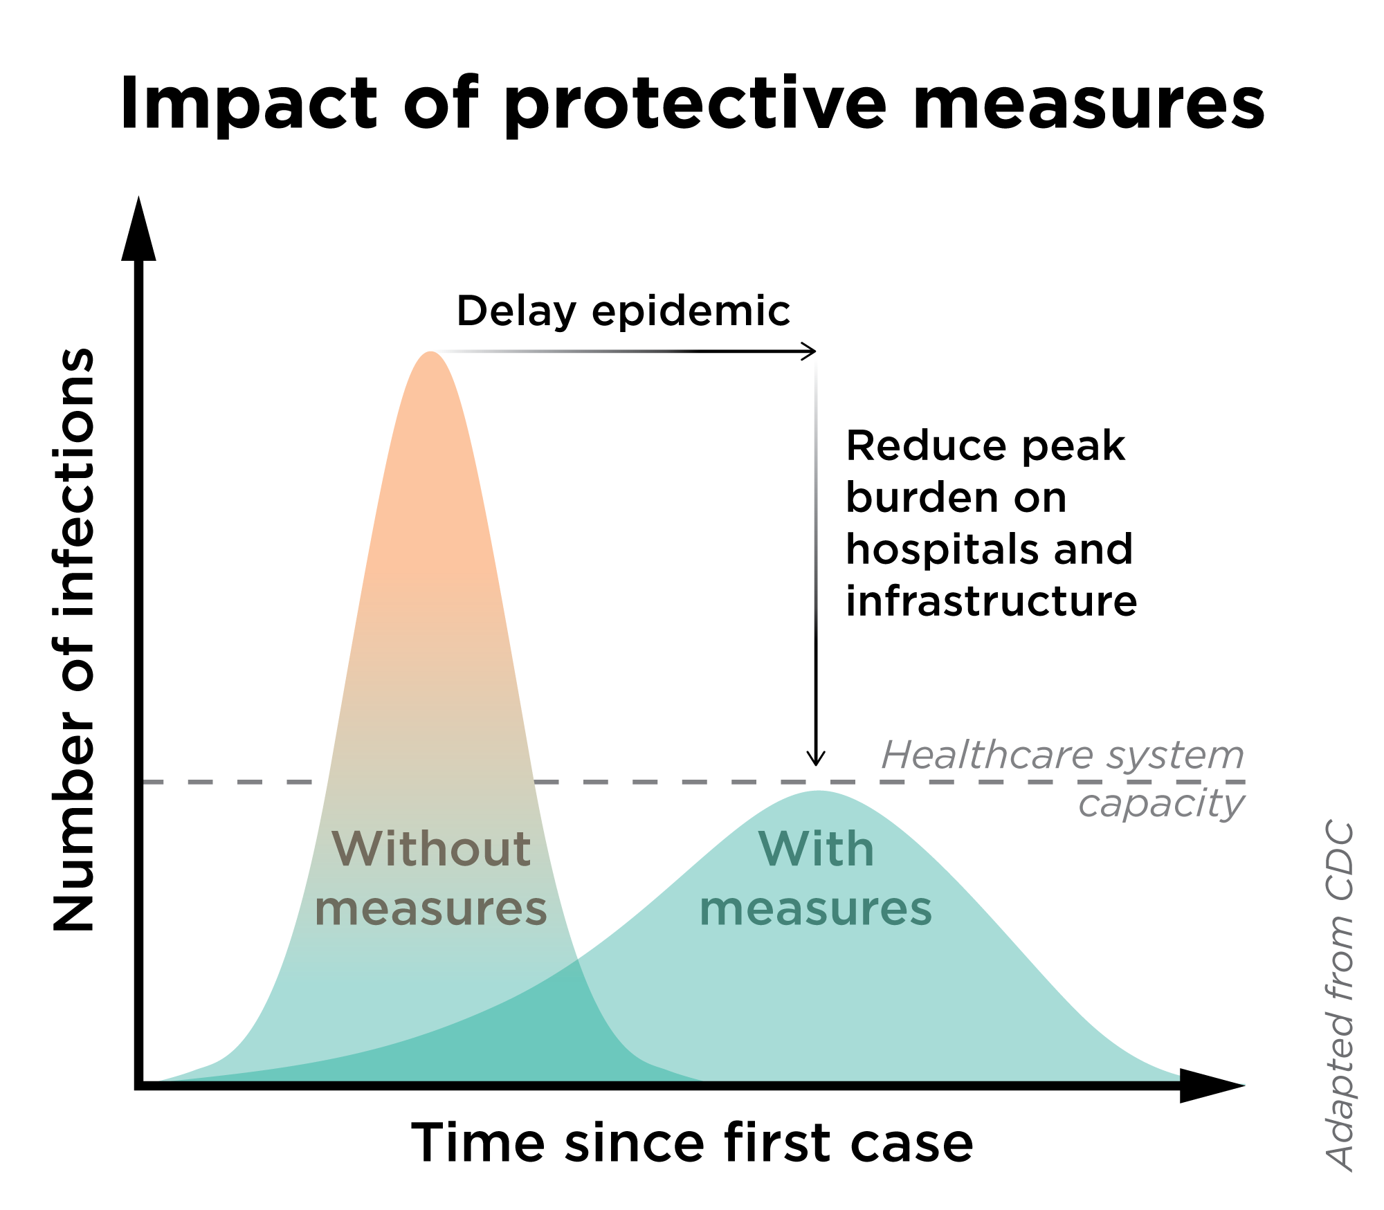
Flattening the curve
The aim of the delay phase of action is to reduce the number of infections and spread them out over a longer period to reduce the pressure on health and social care and wider societal infrastructure.

Slide 11
National Guidelines
Over the last couple of weeks there has been rapid increase in the guidelines from government for organisations of different types. There remain gaps but there are teams working hard nationally to fill them as the research providers more information.
These include the following for the non-health sector:
COVID-19: guidance for educational settings
COVID-19: guidance for employers and businesses
COVID-19: guidance for social or community care and residential settings
COVID-19: guidance for staff in the transport sector

Slide 12
Business Continuity Planning
The aim of business continuity planning in the context of Covid19 is to prepare organisations and teams to cope with significant staff absence due to sickness absence (including self-isolation), caring leave and bereavement leave.
Up to 50% of the workforce may require time off at some stage over the entire period of the pandemic, with individuals likely to be absent for a period of up to 14 days.
Absenteeism should follow the pandemic profile, with an expectation that it will build to a peak lasting for two to three weeks (expected in April/May), when between 15% and 20% of staff from the workforce may be absent, and then decline.
Important to note that sickness absence may be higher in small teams for periods of 2-3 weeks if there is a cluster, or a group of staff self-isolating following a case in the workplace.
If we step up the Flu Plan and move into business continuity and emergency planning mode then staff will be asked to support us by working flexibly in relation to the business need to ensure that the Council and the City continues to function as effectively as possible.

Slide 13
BCC Internal Action
Coronavirus Preparedness Group has been meeting for several weeks bringing together leads from across the business to plan as the situation develops.
Additional capacity for coms & business support started to support DPH from 02/03/20, additional OD support from 06/03/20.
Increasing communication with staff and elected members, including Yam Jam with Director of Public Health, CEO email, Managers Briefing on Isolation guidance, Building management messages. Messaging added to corporate desktop screens.
Directors have been updating business continuity plans and there has been a training update session for business continuity leads.
Commissioners have been prompting providers to test business continuity planning, especially in social care.
Significant engagement with Chinese Community around community tensions led by Community Safety & Resilience.
On-going work to map potential economic impact working with WMCA.
Review of estate footprint and cleaning arrangements, ordering of hand sanitizer stock for high footfall BCC venues, increasing availability of soap in kitchens and increased signage.
Stand down all non-essential international business travel.

Slide 14
BCC Next Steps w/c 09/03/20
PH Division moving into business continuity mode to release more specialist capacity to support response. This will include an identified Service Manager lead for each directorate to support liaison.
CLT reviewing business continuity plans for co-dependencies, followed by ELT session to test shared understanding and approach as one council.
Communication road show to ensure message reaching sites with workforce with low digital access e.g. depots.
Initiate entrance & canteen hand sanitisers in high volume CAB locations and some other sites. Increase soap in all kitchen facilities & increase signage & handwashing awareness.
Initiate weekly YamJam for staff and weekly Covid19 staff briefing.

Slide 15
BCC External Action
Active promotion of national messaging via BCC platforms and social media.
BCC extranet web-page created to signpost to national advice and information.
DPH providing ad hoc advice & input to NHS, Universities, Schools, Businesses & Vol. sector and WMCA.
Significant work from DPH support NHS and PHE in developing response & approach as situation changes.
Cascading advice/guidelines to partners through directorates.
Media briefing and engagement around first case in Birmingham.

Slide 16
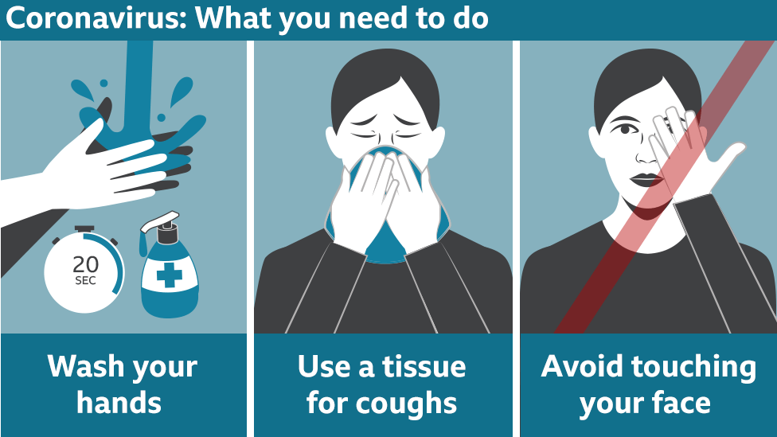
Key Message

Slide 17
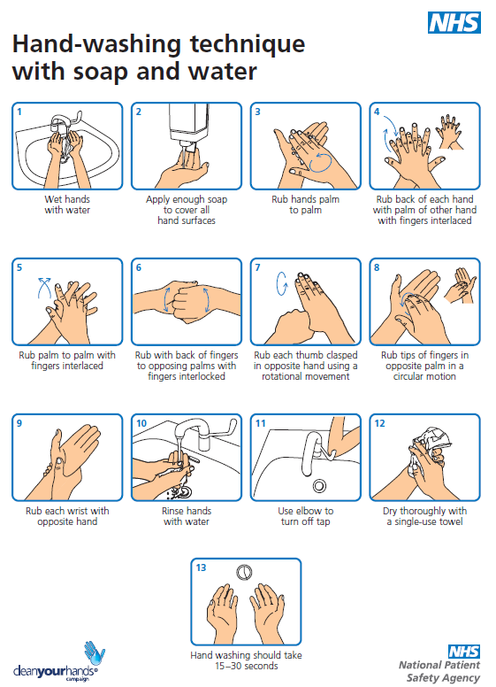
Handwashing Guidelines
Water and soap is better than hand sanitizer.
Bar soap is as good as liquid soap.
Hand sanitizer must include over 60% alcohol to be effective.
Advice is to wash hands more frequently and for at least 20 seconds (2 rounds of happy birthday).

Slide 18
Message for Managers
Remember your staff will look to you to set the tone and approach. There is one case in Birmingham currently and we are well prepared. Please be aware of your response and language.
We are producing central guidance as one Council, please use this to brief staff and do not create ad hoc briefing or cascade media information without discussion with your director or the central Covid team.
Review your forward plan for any conferences or large scale events and consider potential risks.
Ensure you are familiar with the directorate business continuity plan and start to plan for the next phase when we start to step down services to prioritise business continuity.

Slide 19
Summary Points
Covid19 is a virus that sits in the family of Coronavirus that includes the common cold; there is widespread media coverage because this is a new strain that is spreading rapidly and is causing significantly more deaths than normal for this virus.
Good respiratory and hand hygiene is the best general defence for everyone.
All staff have a role in supporting the City, and staff, to remain calm and proportionate in our approach.
There will be on-going and detailed comms in the coming days/weeks to clarify BCC led actions as the situation escalates.

